Slide 1
Courant Math 2799.001
Securitized Products & Structured Finance
Lecture 3: MSRs, Whole Loan Swap into MBS, Agency CMO’s
April 8, 2024
Prof: Rodney Sunada-Wong rsw8@nyu.edu
TA: Edison Lee el2700@nyu.edu

Slide 2
Topics
Homework from previous lecture
Mortgage Servicing
Swapping whole loans into MBS
CMOs
IO / PO
Floater, Inverse IO
Sequential
PAC & Companion
Sequential PAC
Type II PAC
Actual CMO Structures
Homework & Reading
Others

Slide 3
Homework from previous lecture
Build a Pass-through composed of 10,000 loans. Each loan, when originated, was exactly $100k in size. There are three pools. The loans in each pool have identical characteristics, but:
Pool 1: 1,000 loans are 15yr fixed-rate 6.40% WAC, 1 months WALA, SMM 0%
Pool 2: 7,000 loans are 30yr fixed-rate 6.80% WAC, 0 months WALA, SMM 1%
Pool 3: 2,000 loans are 30yr fixed-rate 7.70% WAC, 3 months WALA, SMM 2%
Note that the issuance of the Pass-though is occurring months after the loans were originated. When calculating the impact of prepayment/curtailment, assume
Pool 2 borrowers just prepay entire loan (nobody curtails). Each month, round the number of borrowers down to a whole number, e.g. in the first month, 70 prepay, leaving 6930 borrowers. The next month 69 borrowers prepay, not 69.3!
Pool 3 borrowers just curtail (nobody prepays the entire loan, except for the very last payment).
Assume the servicing fee + g-fee is 75bps.
For each pool, and each month, calculate the unpaid balance, scheduled principal payments, unscheduled principal or curtailments, interest expense, WAC, WAL, SMM.
Calculate the same metrics for the pass-through as well as the net coupon.
Explain the drivers of trends in WAC, WAL, SMM

Slide 4
15yr, 6.4% WAC, 1 month WALA, SMM 0%
0% SMM => individual loan profile and pool profile do not differ
Data: Math2796.001_lect4 30yr passthrough v5 202404.xlsx

Slide 5
30yr, 6.8% WAC, 0 mths WALA, SMM 1%, Prepayments (rounded down)
Prepayments => Individual loan and pool profiles differ
Data: Math2796.001_lect4 30yr passthrough v5 202404.xlsx

Slide 6
30yr, 7.7% WAC, 0 mths WALA, SMM 2%, Curtailments
Prepayments => Individual loan and pool profiles differ
Data: Math2796.001_lect4 30yr passthrough v5 202404.xlsx

Slide 7
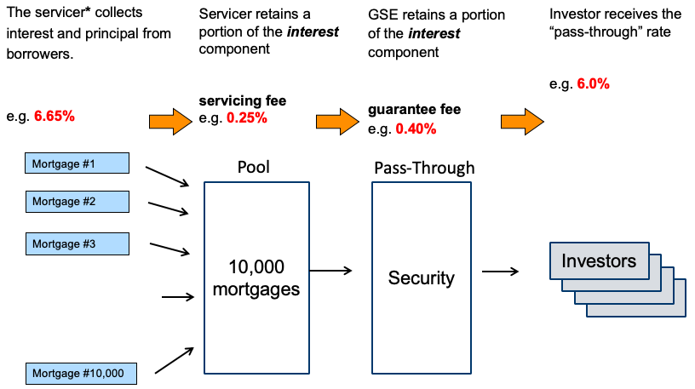
Mortgage Servicing
In the spring of 2020, strange things happened with mortgages. This topic covers the “nuts and bolts” of “servicing”.
As noted in the last lecture, the “mortgage servicer” earns fees for “servicing” the mortgages
“Servicing”
- entails not only collecting “P&I” (Principal, Interest) from borrowers, but
- ensuring that P&I is forwarded to the owner of the mortgage on a timely basis, even if a borrower is delinquent
- working with borrowers if they are delinquent to “maximize recovery”

Slide 8
Who performs Mortgage Servicing if the bank keeps the loans?
If the bank keeps on its books the mortgages it has originated (instead of selling them to a third party):
- the bank may be the party performing the servicing, OR
- the bank could sell the Mortgage Servicing Rights “MSR’s” to a third party, who would
receive the servicing rights during the life of the mortgages
take on all responsibilities for servicing the mortgage
Given that Mortgage Servicers hedge their “pipeline” with TBA’s how did that hurt them, when the FED bought bonds and MBS in Interest rates dropped in March/April 2020?
They hedge by short TBAs and when r decreases TBA prices increase and the hedge loses money. Also, they need more cash to post margin to TBA
Breakout Rooms

Slide 9
Who performs Mortgage Servicing if the bank sells the loans?
If the bank sells the mortgages to another party, they could be sold as as whole loans
(the third party might aggregate these mortgages with other mortgages to
keep them on balance sheet, or possibly to swap into MBS
The sale of the whole loans would be either
“Servicing Released”
Sell all the cash flows, including the MSR’s i.e. the other party takes on the servicing responsibilities
“Servicing Retained”
Sell everything but keep the Mortgage Servicing Rights “MSRs”
In this case, the bank can either service the loans, OR
Also choose to sell the MSRs to a third party

Slide 10
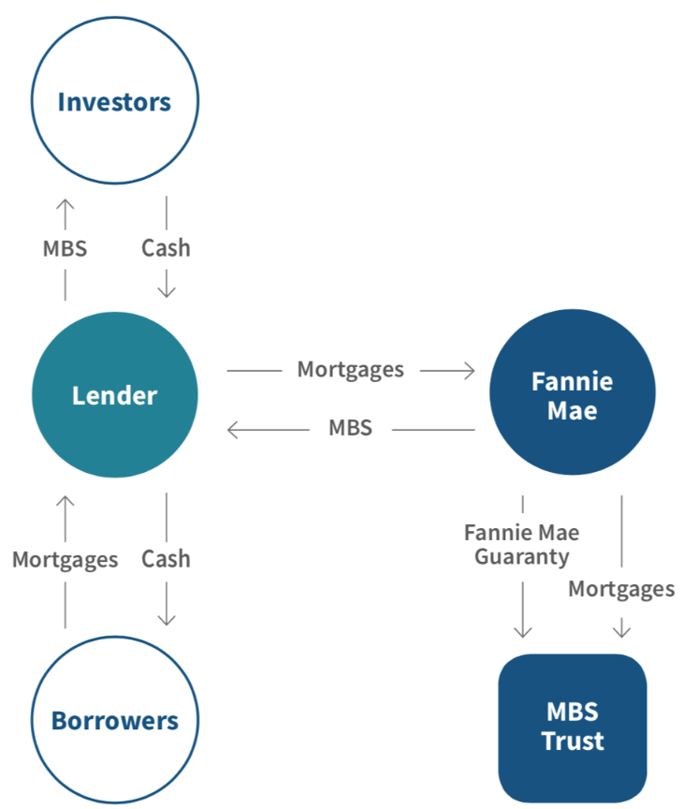
And if the bank sells the loans?
But the bank could also sell the mortgages to another party as agency-backed MBS
The bank again could either continue to service the mortgages or sell the MSRs to a third party

Slide 11
P.S. The bank could also keep the loans as MBS
The bank could swap the whole loans into Agency-wrapped MBS and keep them on balance sheet
What are potentially two reasons for doing this?
Do not take credit risk, since Fannie Mae takes that;
Regulatory capital charges are less
Breakout Rooms

Slide 12
Collateralized Mortgage Obligations (CMO’s)
What are they?
Derivatives of Pass Throughs
Slice and Dice the cash flows
Principal, Interest
Prepayment
Time
Etc.
Key Concept: The sum of the principle of the parts must equal the whole principle

Slide 13
Collateralized Mortgage Obligations (CMO’s)
Different Investors have different needs, preferences:
Duration
Pass Through may not be ideal asset/liability match for investor
Some investors want just floating rate bonds
Banks buy short average life bonds
Insurance companies buy long average life bonds
Prepayment risk
Some Investors do not want to take this risk
Some Investors are willing to take more ppmt risk because of the higher yield
Some investors may have a view
Key Question: What are the originator’s and GSE’s motivations for issuing CMOs? (Hint: Think about how on airplanes there are different kinds of seats.)
maximize the difference between the yield receiving on the mortgage and the cost of issuing the securities
Breakout Rooms

Slide 14
Types of CMO’s
Unlimited number of ways to structure cash flows
Some basic structures used, and then combined together
1) Slicing and dicing interest coupons
IO; PO: stripped down interest: allows the creation of higher/lower coupon bonds
Floater; Inverse Floater: floating rate bonds
Inverse IO: interest only inverse floater

Slide 15
Types of CMO’s
2) Slicing and Dicing Principal Payments
Sequential: bond principal is paid one after the other
PAC, TAC (Planned Amortization Class, Targeted Amortization Class): bonds are paid on a schedule, more stable than sequential
Support / Companion: supports the PAC or TAC by absorbing the difference between actual collateral prepayments and the schedule
Others
Z: “zero-coupon” until the bond begins to pay principal
VADM (Very Accurately Defined Maturity): extremely stable bonds immune to extension risk

Slide 16
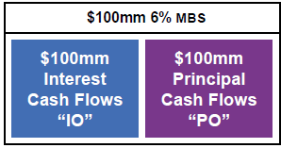
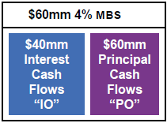
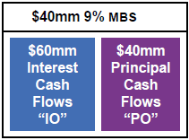
IO / PO
Can cut cash flows into Interest-Only (IO) tranche and Principal-Only (PO) tranche
POs are positively convex and often have low yields
IO’s are very negatively convex and offer large yield pickups
G-fee and Mortgage Servicing Rights (MSRs), are examples of cash flows that are essentially like interest coupons (the amount collected is a % times the outstanding notional)
$100mm * 6% = $6mm interest
By re-combining collateral cash flows, we can create bonds with a higher or lower coupon
$60mm * 4% = $2.4mm interest
$40mm * 9% = $3.6mm interest
Source: L. Gauthier

Slide 17
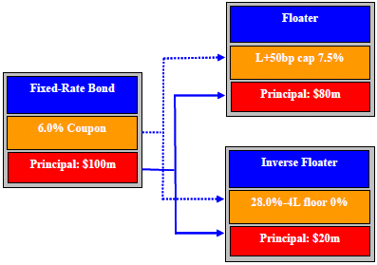
Floater and Inverse Floater
Agency CMOs backed mostly by fixed-rate collateral
A floating-rate bond can be created from fixed-rate collateral by using the fixed coupon to pay two tranches:
a floater indexed to LIBOR
an inverse floater indexed to -LIBOR.
The sum of the floater and inverse cash flows equals the fixed-rate cash flow.
The floater is capped to prevent the inverse from having a negative coupon if interest rates are very high
If $100MM net coupon 6% then $80MM floater coupon = min( LIBOR + 50bps, 7.5% );
$20MM inverse coupon = max( 0 , 28% - 4*LIBOR) )
(notice: the sum of the notionals = $100MM)

Slide 18
Floater and Inverse Floater – why? what are the risks?
Key things to think about
Why would investors be interested in these securities?
Why would the Issuer structure these securities?
What are the differences in risks for these securities vs a fixed-rate passthrough?
Floater almost have no risk but the sum of risk of floater and inverse floater should equal to the risk of the fix rate bond. So the inverse floater has much more risk
How do the yields (or spreads) for these securities compare to each other and to the yields (or spreads) for a fixed-rate passthrough? Why?
Yield: inverse floater > fixed rate bond > floater
$80MM floater coupon = min( LIBOR + 50bps, 7.5% );
$20MM inverse coupon = max( 0 , 28% - 4*LIBOR) )
Breakout Rooms

Slide 19
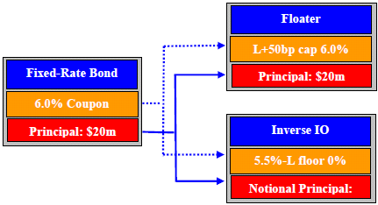
Floater and Inverse IO (“Interest-Only”)
A floating-rate bond can be created from fixed-rate collateral by using the fixed coupon to pay two tranches:
a floater indexed to LIBOR
an inverse IO that pays a coupon indexed to –LIBOR, but does not pay any principal
The sum of the floater and inverse IO equals the fixed-rate cash flow.
The floater is capped to prevent the inverse IO from having a negative coupon if interest rates are very high
If $100MM net coupon 6% then $100MM floater coupon = min( LIBOR + 50bps, 6% );
$100MM inverse IO = max( 0 , 5.5% - (LIBOR + 50bps) )
notice: the sum of notionals <> $100MM. The second has no principal

Slide 20
Floater and Inverse IO (“Interest-Only”)
Key things to think about
Why would investors be interested in these securities?
Why would the Issuer structure these securities?
What are the differences in risks for these securities vs a fixed-rate passthrough?
How do the yields (or spreads) for these securities compare to each other and to the yields (or spreads) for a fixed-rate passthrough? Why?
Inverse IO > fixed > floater
$100MM floater coupon = min( LIBOR + 50bps, 6% );
$100MM inverse IO = max( 0 , 5.5% - (LIBOR + 50bps) )
Breakout Rooms

Slide 21
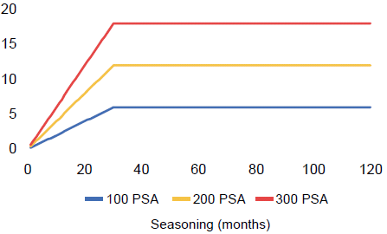
Before looking at other CMO’s, let’s review PSA
The pricing speeds and corresponding metrics, like WAL, principal payments, etc. for certain CMO’s are often quoted in terms of PSA
PSA (“Public Securities Association”). A prepayment speed of 100 PSA is a CPR vector that ramps up from 0.2% CPR to 6% CPR over 30 months as a function of seasoning, and then is constant at 6% for the remainder of the life

Slide 22
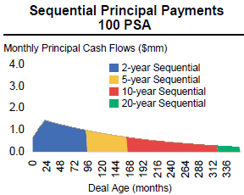
Sequentials
A CMO with sequential-pay tranches, is divided into classes where each class receives interest payments, like usual, but:
The 1st class receives all of its principal before the 2nd class receives any principal payments
The 2nd class receives all of its principal before the 3rd class
Etc.
Issuer of CMO offers investors maturities, principal payment periods and WALs different from the underlying Pass Through
Terminology:
“Lock-out period”
“Principal pay-down window”
*
* The phrases “2-year Sequential”, “5-yr sequential”, etc. are nicknames. They roughly describe how long the principal payments might last for these tranches. Also, note that 100 PSA is very slow. 300-500 is more typical
Source: L. Gauthier

Slide 23
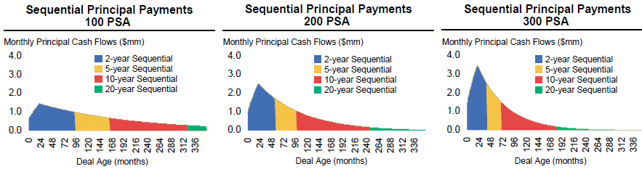
Sequential: WAL for different PSAs
Sequentials still susceptible to prepayment risk

Slide 24
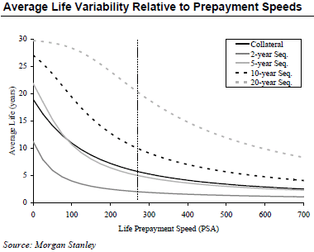
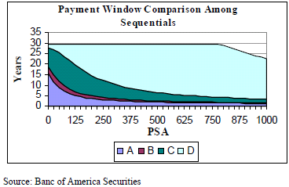
Sequential: WAL for different PSAs
Sequentials still susceptible to prepayment risk
First tranche WAL generally least sensitive to PSA. Why?
Last tranche WAL not as sensitive as middle tranches. Why?

Slide 25
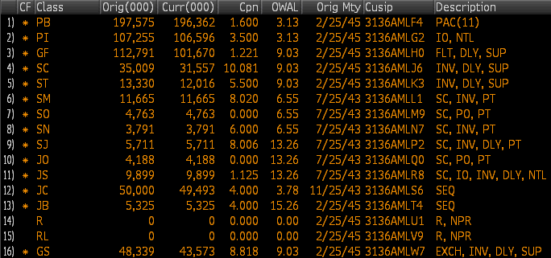
FNR 2015-1
Has 16 classes. We focus on two sequentials.
Notice Notionals, coupons, OWAL

Slide 26
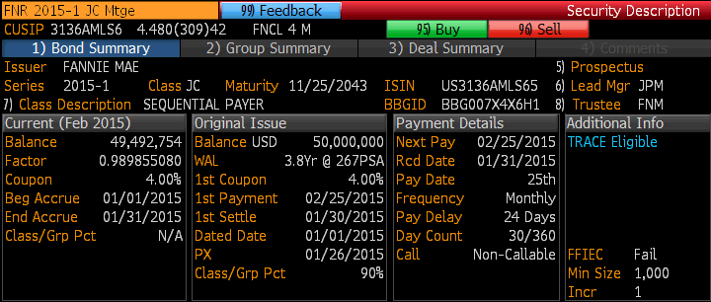
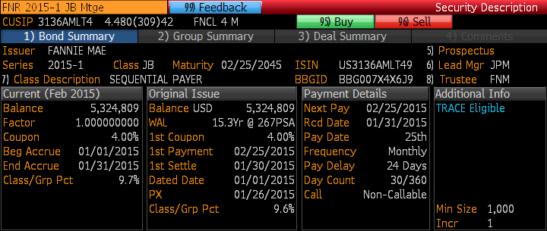
FNR 2015-1 JC, JB
Compare
Factors
WALs
Notice: the Balance of the first sequential $49,492,754 has fallen below the original Balance of $50mm,
but the second sequential’s balance is unchanged.
The interest received by each tranche each mth is the current Balance * the interest rate (4%) * 30 / 360

Slide 27
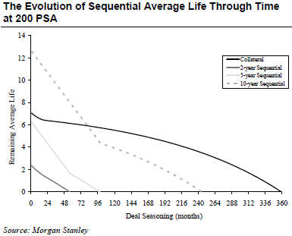
Sequential: WAL as time passes
Sequential WALs “roll down the curve” more rapidly than Passthrough WALs
Attractive when yield curve is steep (assuming the yield curve does not change as we step forward in time)
In 2011, given the upward-sloping yield curve, the discount rate for a cash flow would decrease quickly as time passes (=> the market price of that CF would increase as time passes)
In 2023, the yield curve is mostly flat after 5 yrs, so there would not be much appreciation in the market price of those cash flows as time passes
Questions: Which should trade at higher yields? The 1st sequential, the 2nd, 3rd, 4th?
Spreadsheet: US Treasury Yield History and Recessions 202209.xls

Slide 28
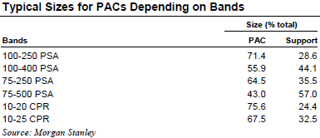
PAC & Companion
A CMO with a Planned Amortization Class, or PAC, is designed to reduce prepayment risk for the investor of the PAC.
In order for the PAC to have less prepayment risk, another class, the support bond or companion, takes on extra prepayment risk
A schedule is created for how much principal the PAC should receive at what point in time
If actual principal payments come in faster than scheduled, the extra principal cash flow is diverted to the companion
If prepayments are slower than scheduled, the companion does not receive principal until the PAC is back on schedule
The wider the PAC bands, the larger the support bond has to be and therefore the smaller the PAC

Slide 29
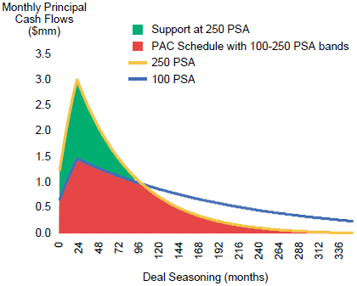
PAC “Bands”
The timing of when the PAC bond will pay principal is based on the minimum of two principal schedules
The Lower Band: based on principal payments corresponding to a slower PSA
The Upper Band: based on principal payments corresponding to a faster PSA
IF actual prepayment is at a constant PSA between 100 and 250, then the timing of principal paid by the PAC and follows the original schedule (the red shape) exactly.
A
B
C
Remember: The sum of the parts must equal the whole!
Source: L. Gauthier
So A + B = B + C

Slide 30
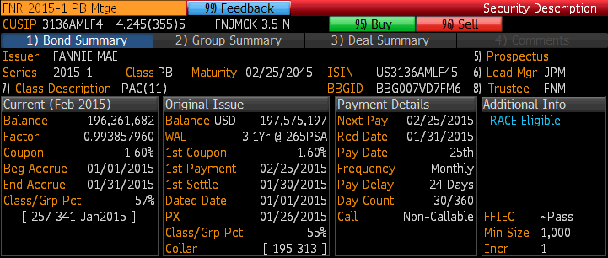
FNR 2015-1 PB

Slide 31
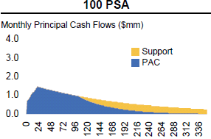
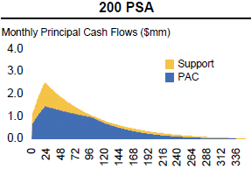
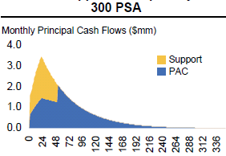
PAC: Effect of speeds on Principal Flows
When prepayments are slow (but speed > the lower band), the PAC is paid and the support extends
With prepayments within the upper and lower bands, the PAC pays as scheduled. Principal cash flows of the support are spread out
When prepayments are faster than the upper band, the support is paid off early. At that point, the PAC is busted, paying principal faster than scheduled. The PAC WAL shortens.
Source: L. Gauthier

Slide 32
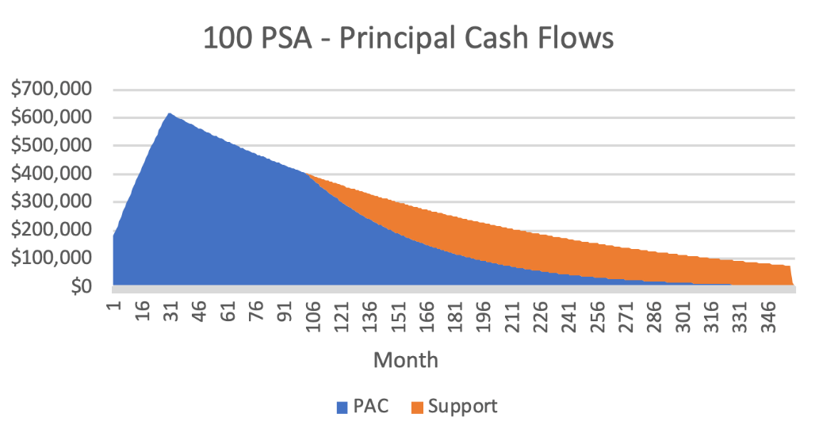
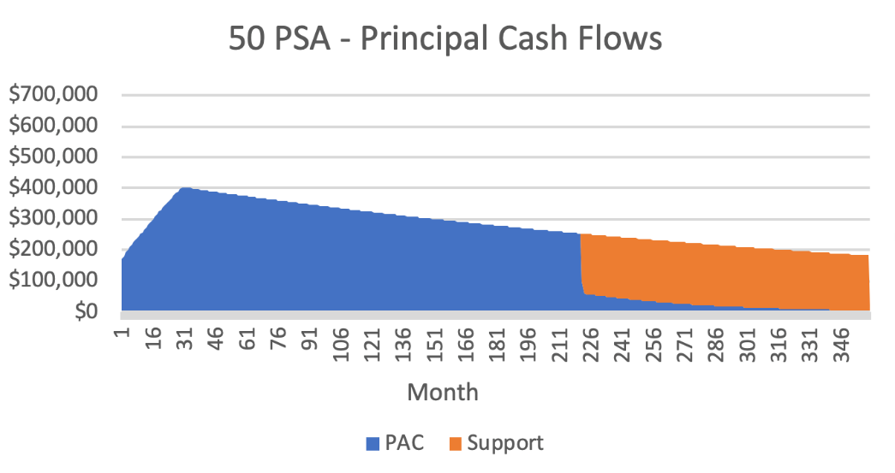
PAC: If lower band breaks – impact on Principal Flows
Cumulative principal payments to PAC are slower than scheduled
Proritize principal payments to PAC until the PAC is back on schedule
Once cumulative principal paid to PAC catches up to the originally scheduled principal, then the allocation of principal returns to to normal
(Note: both the PAC and the Support bond “extend”.)

Slide 33
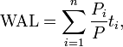
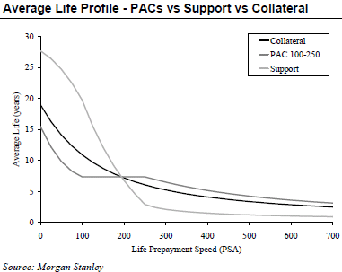
PAC vs Sequential vs Collateral WAL
As designed, the
PAC WAL is less sensitive to prepay speeds than the collateral is
The Support bond is more sensitive than the collateral is
Within the upper and lower PAC bands, the PAC WAL is stationary
The Companion / Support Bond absorbs faster or slower prepayments
When speeds are
below the lower band, the PAC extends
above the upper bound, the PAC contracts

Slide 34
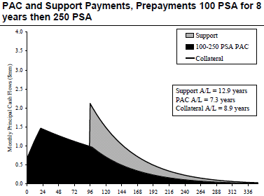
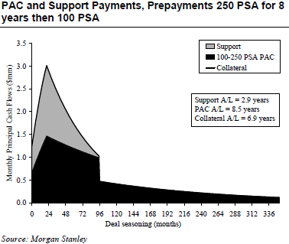
Non-constant speeds: impact on PAC
Even if speeds are within the upper and lower bands, if they are not constant, the PAC can be busted
Faster speeds are more likely than slower speeds to bust the PAC, as faster speeds erode the protection provided by the Companion
Questions: which should trade at higher yields? PAC vs Passthrough vs Support Bond? Why?
Breakout Rooms

Slide 35
PAC yields
PACs trade at tighter nominal spreads than Pass-Throughs do because they are less sensitive to prepayments than the underlying collateral is.
For similar reasons, Supports typically trade at wider spreads than collateral.

Slide 36
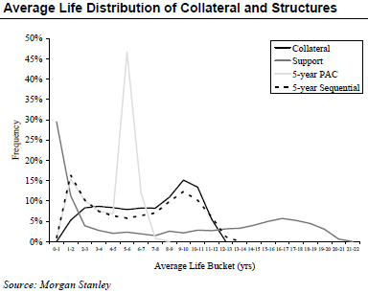
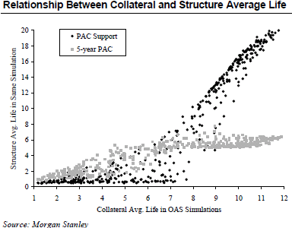
More about WALs
As constant prepayment speeds are unrealistic, consider:

Slide 37
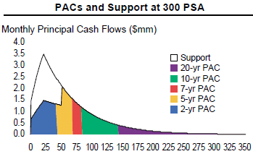
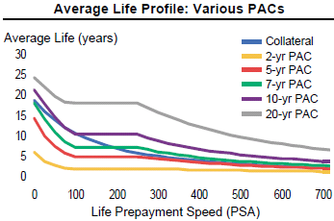
Sequential PAC
As noted before, structures can be combined
PACs are often sequentially cut up into tranches to cater to investors’ WAL preferences
Shorter PACs are typically more protected against prepayments variations than longer PACs
The Support is more likely to be around while a short PAC is outstanding
By the time a long PAC begins receiving principal, the Support might have paid off
Banks like short PAC sequentials because cash flows are relatively stable, and they offer higher yields than short Treasuries
Questions: Which trades at higher yields? 1st PAC sequential or a regular PAC?
Source: L. Gauthier
Breakout Rooms

Slide 38
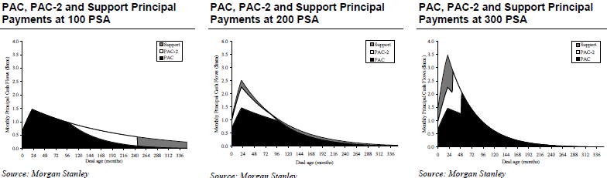
Type II PAC
For investors willing to take on prepayment risk in return for a higher yield
A PAC can be created out of the Companion in a standard PAC structure
If prepayments are
within (narrower) PAC bands, then the Type II PAC pays as scheduled
Faster, then the Type II PAC serves as a companion to the standard PAC
Questions: Which trade at higher yields? Type II PAC or PAC? Support for PAC or for Type II PAC?
Breakout Rooms

Slide 39
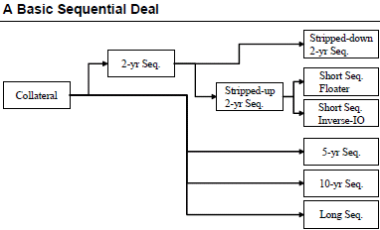
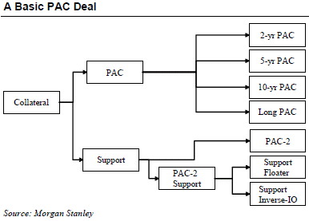
Actual CMO Structures
A series of PACs with specific WAL targets might be ~70% of the whole deal. 30% could be Type II PAC and a PAC-2 support.
PAC-2 might have a high yield, with prepayment protection but significant extension risk.
The PAC-2 support could be split into a floater with a large margin, to compensate for WAL variability, and an inverse-IO for risk-prone hedge funds.

Slide 40
Homework
Read Ch. 15 of Salomon Smith Barney Guide to Mortgage-Backed and Asset-Backed Securities by Lakhbir Hayre
For a $100MM pool of 6.50% WAC 30yr loans with 70bps servicing/g-fee
Create a Sequential structure with 4 tranches :
A: $45MM, B: $25MM, C: $20MM, D: $10MM
For ten PSA scenarios (from 50 PSA to 500 PSA in increments of 50), calculate and graph WAL for each tranche (x-axis: PSA speed, y-axis: WAL)
List the tranches in declining order of sensitivity (of WAL as a function of PSA) and explain why these tranches are in this order
For the same pool
Instead create a PAC structure with one PAC (with 100 and 250 PSA bands), and one Companion, assuming they pay the same coupon. (To calculate the initial notional of the PAC, sum up the smaller of each month’s principal cash flows under 100 PSA and under 250 PSA. The Companion’ notional will be [$100MM – the PAC notional].)
For the ten PSA scenarios, generate graphs of principal cash flows for the PAC and for the Companion, and explain why the PAC busts or does not bust for the different scenarios.
Remember: The sum of the parts must equal the whole!

Slide 41
Appendix
Even more CMOs

Slide 42
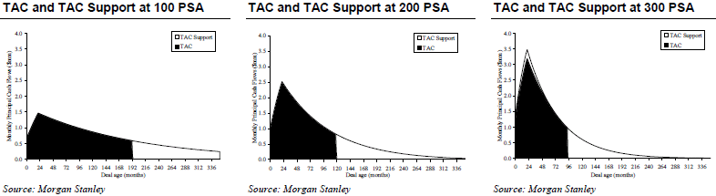
TAC
Targeted Amortization Class are similar to PACs but only protect against fast prepayments, not slow prepayments
At the pricing speed (e.g. 268 PSA), scheduled payments on a TAC are comparable to a front sequential; the TAC support is comparable to a back sequential
If prepayments are faster than expected, the supports jumps in front and absorbs the principal cash flow difference as with a PAC, so the TAC is protected against contraction
If prepayments are slower than expected, the support stays in the back, and the TAC extends, similar to a front sequential

Slide 43
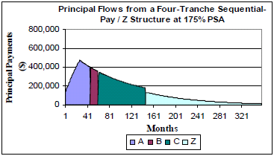
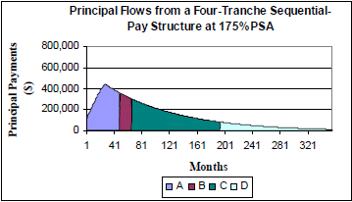
Z (Accrual)
So far, have discussed redirecting Principal
For a sequential structure with a Z class, the interest and principal of the last sequential are used to accelerate repayment of the front sequentials
Deferred interest accrues, increasing the balance of the Z, until the earlier sequentials are paid off, at which point, the Z pays interest and principal
The front sequential benefits from the “Accretion Direction” from the Z’s interest, hence referred to as an “AD” Sequential.

Slide 44
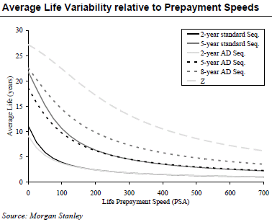
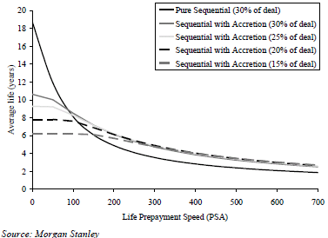
Z (Accrual)
AD Sequentials do not extend as much as standard Sequentials.

Slide 45
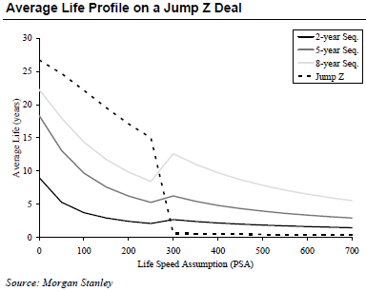
Jump Z
Jump Z
Back-end Z tranche becomes a front sequential (a money market) if a prepayment speeds are faster than a certain threshold (CPR typically)
The Jump Z protects the other tranches against contraction
Sticky (Sticky Jump Z)
Not Sticky (Non-Sticky Jump Z)

Slide 46
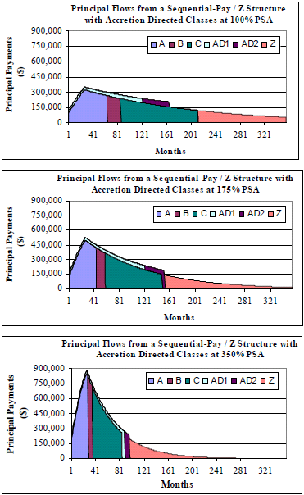
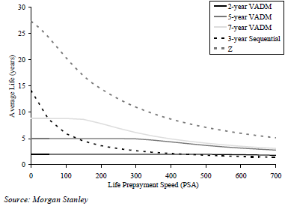
VADM
Direct the Z’s interest to paying principal on a very small sequential, the Very Accurately Determined Maturity (VADM) tranche.
If prepayments are slow, little principal cash flow but lots of interest
If prepayments are fast, little interest, but there lots of principal
Consequently, VADMs are very stable
Though if prepayments are very high, the VADM can contract

